Slide 1

WAY TO ENTERPRISE
AWS
VTI ACADEMY
Author: duy.nguyenngoc1@vti.com.vn

Slide 2
Agenda
Relational Database Service
Aurora Service
DynamoDB Service
ElasticSearch Service & OpenSearch Service
Backup Service
Assignments
Quiz
Copyright © VTI Academy All Rights Reserved

Slide 3
Introduction
Database Service in AWS
  Relational Database Service (SQL)
  Aurora (SQL – MySQL/PostgreSQL)
  DynamoDB Service (NoSQL)
  Redshift Service (Data Warehouse) (Next Lesson)

Slide 4
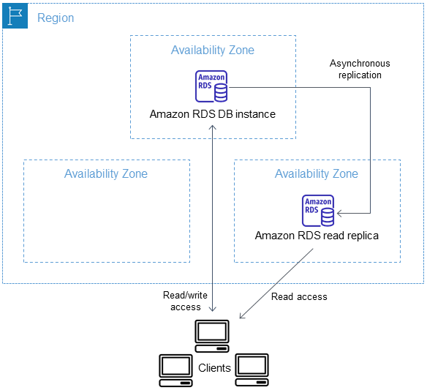
Relational Database Service
RDS stands for Relational Database Service
Is EC2 instance, support Relational Database
  Postgres, MySQL, Oracle, SQL Server, Aurora - AWS Proprietary database
Horizontal & Vertical scaling, distributed storage
Regional service
Price: https://aws.amazon.com/rds/pricing
Multi-AZ deployment
Tutorial: https://docs.aws.amazon.com/AmazonRDS/latest/UserGuide/Welcome.html

Slide 5
Relational Database Service
Demo
  Create Database
  Connect to Database

Slide 6
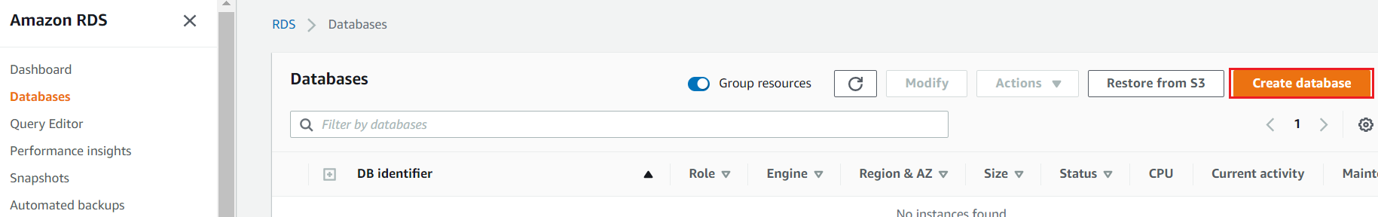
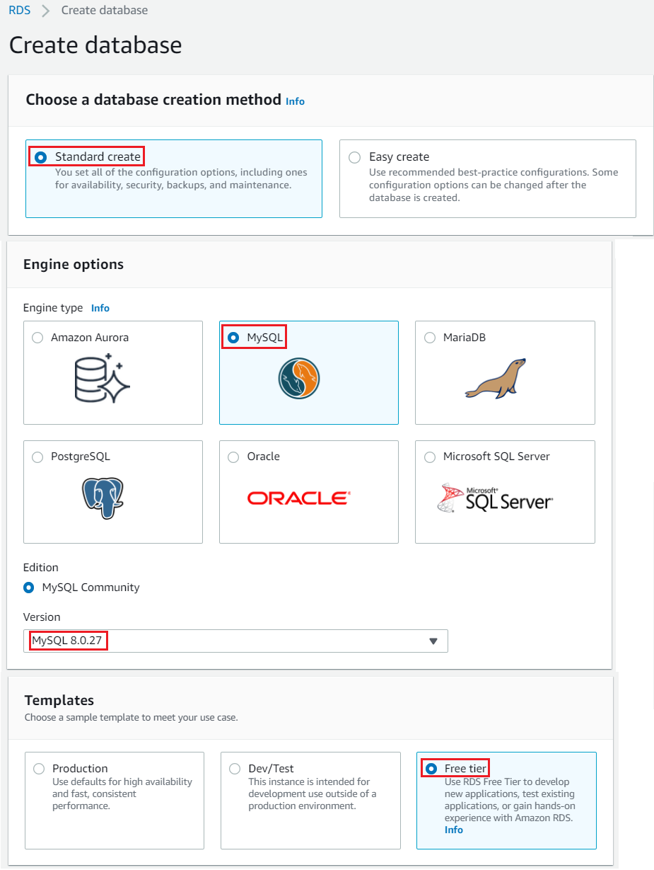
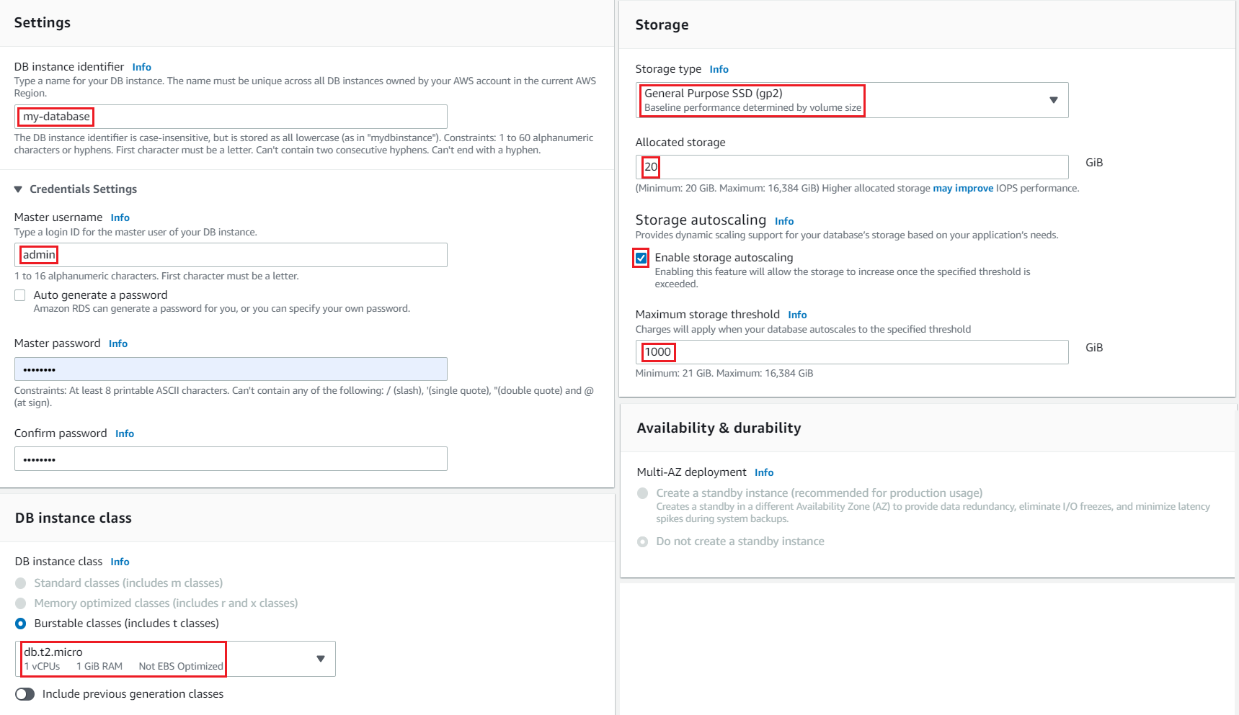
Relational Database Service
  Create Database

Slide 7
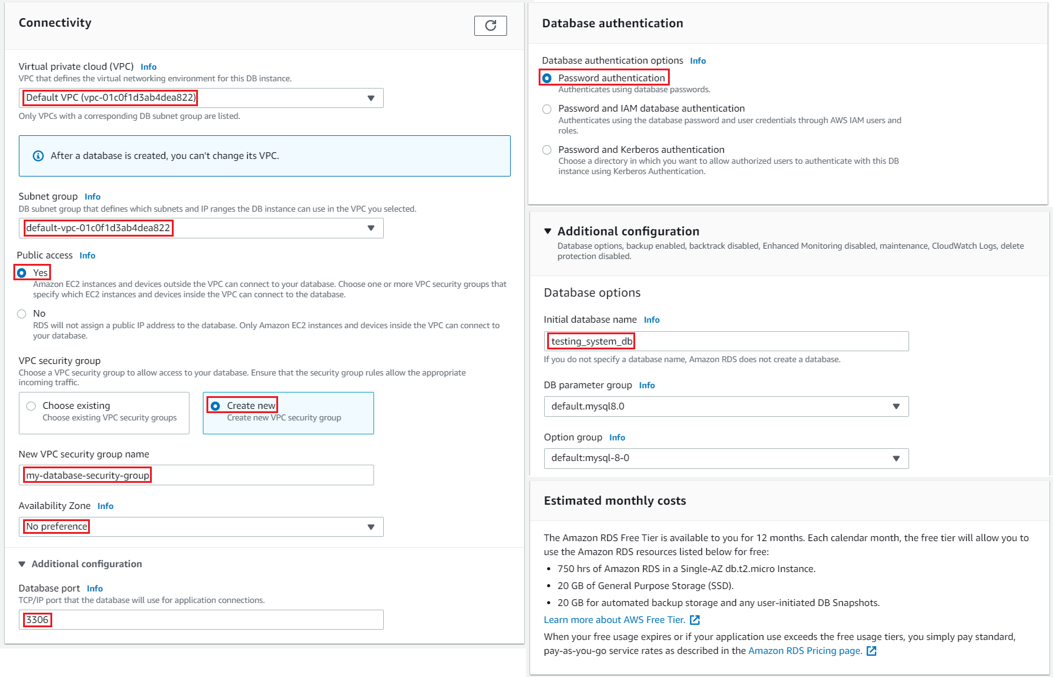
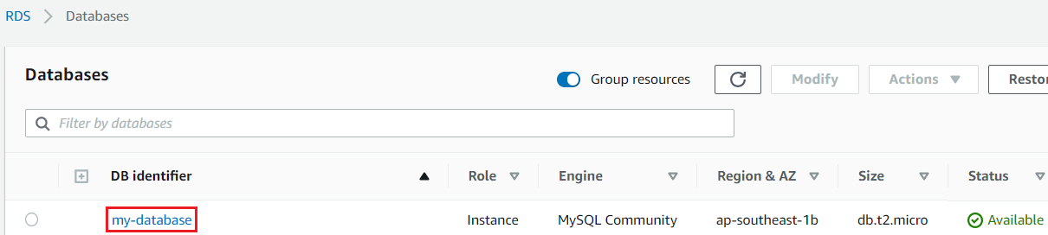
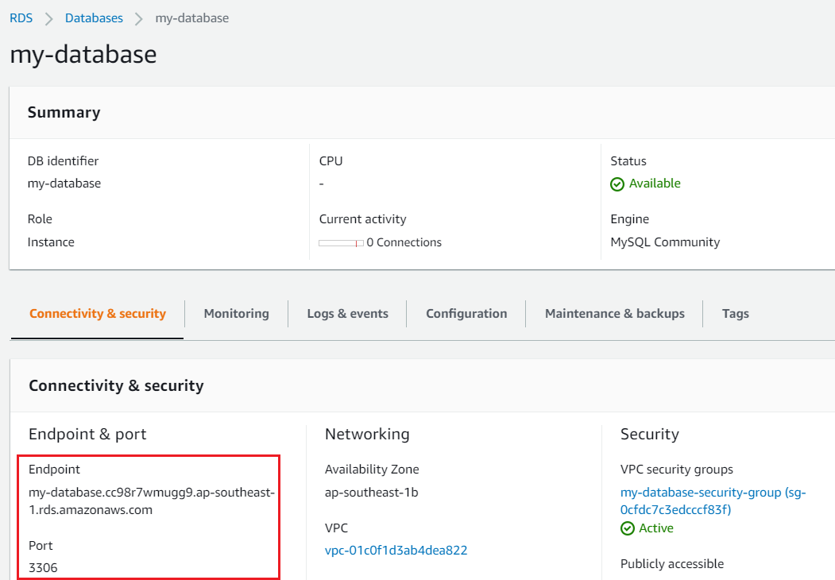
Relational Database Service

Slide 8
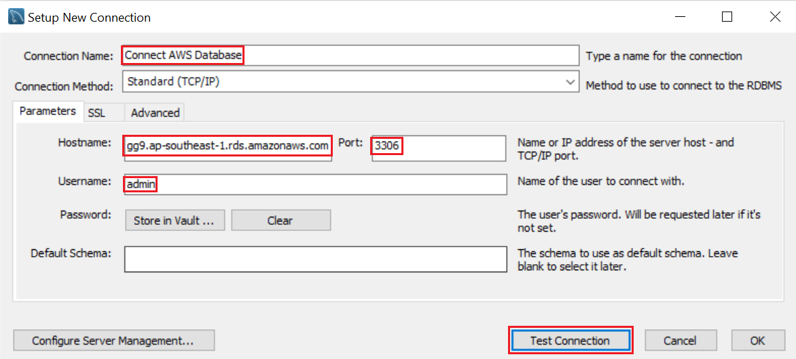
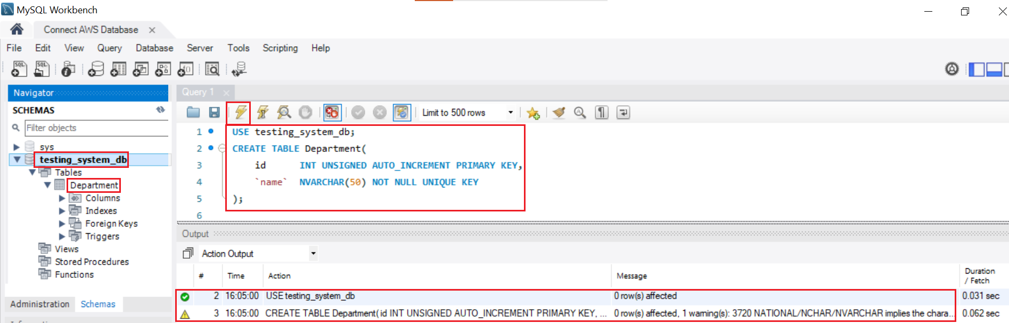
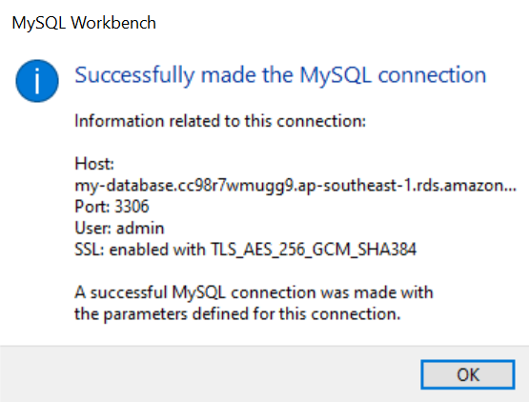
Relational Database Service
  Connect to Database
MySQL Workbench

Slide 9
Assignment
  Self-practice

Slide 10
Relational Database Service
Components
  DB instances
  Deployment

Slide 11
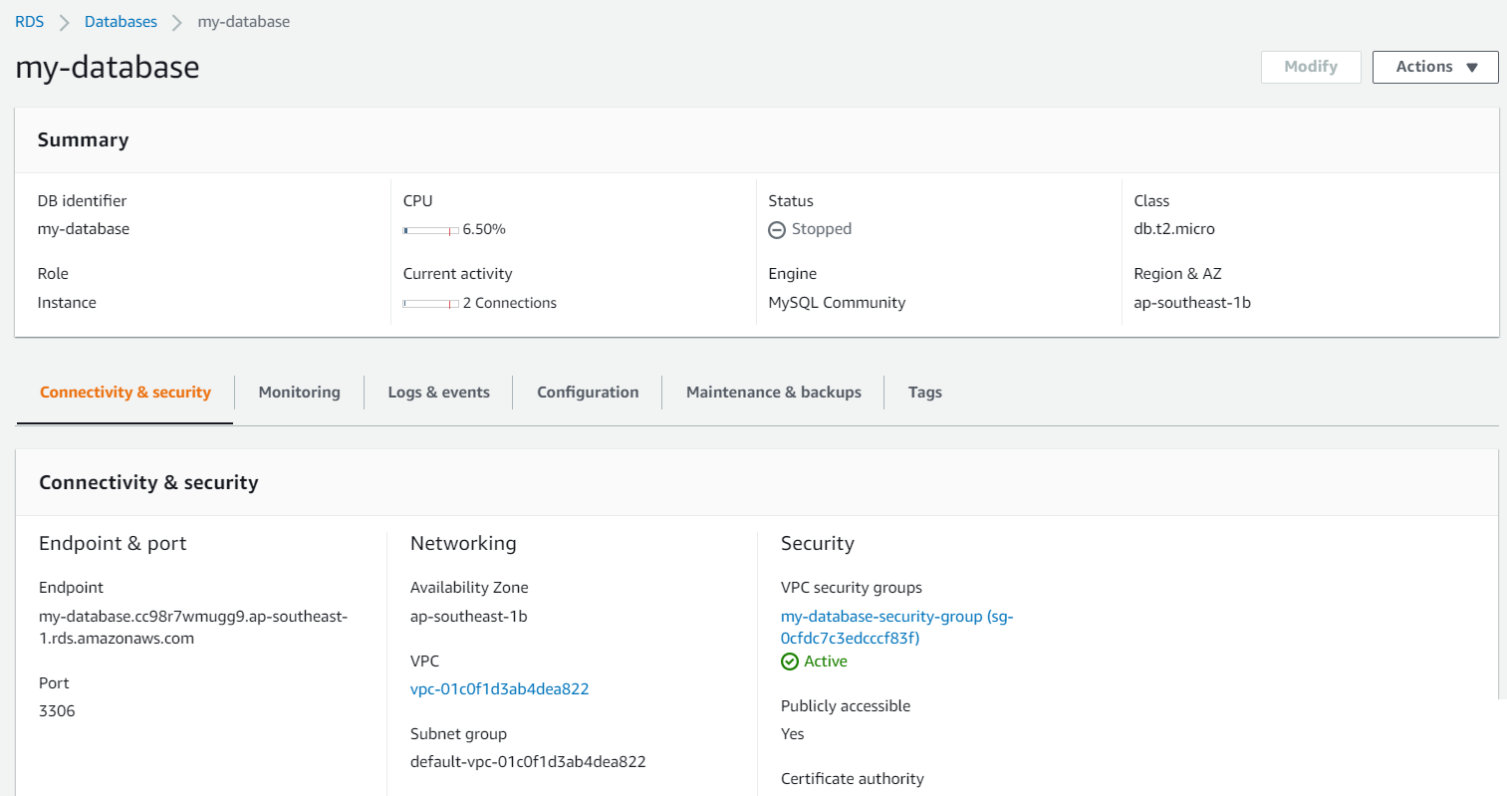
Relational Database Service
  DB instances
    Is EC2 Instance which is installed database software

Slide 12
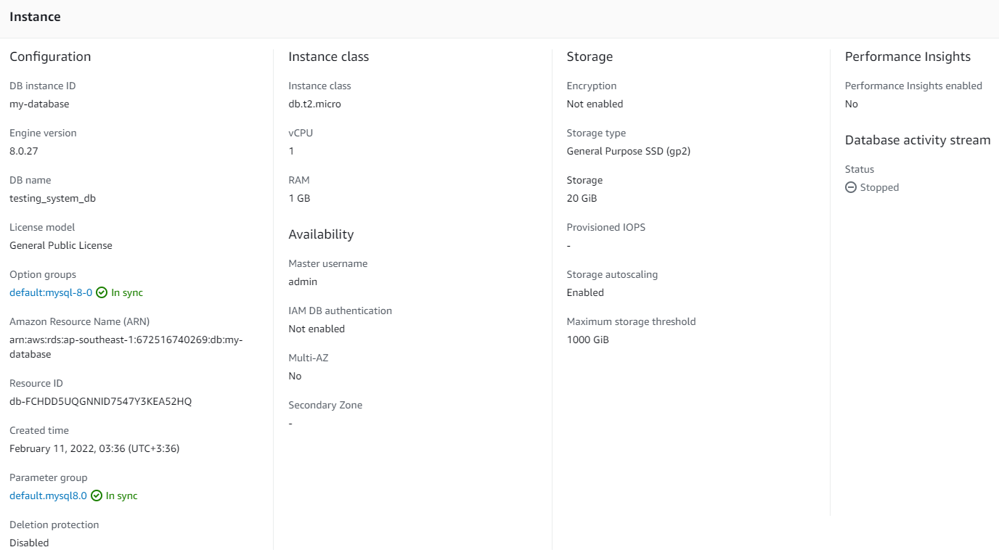
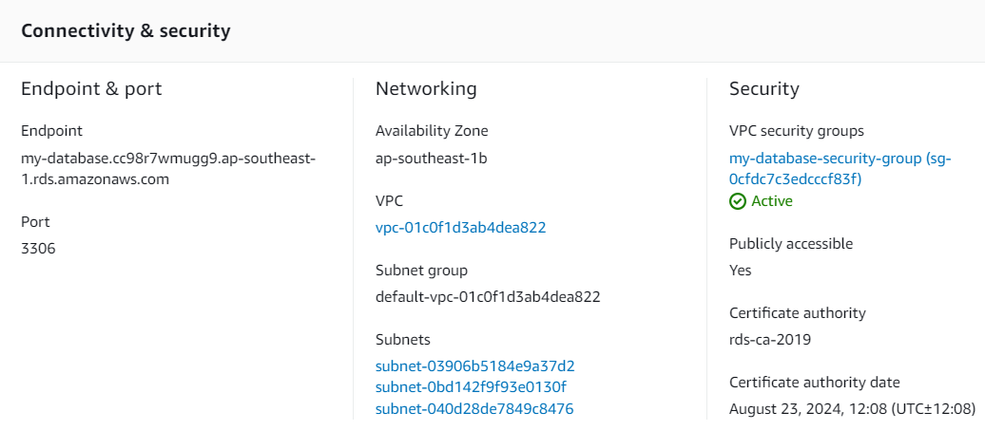
Relational Database Service
    Including:
      RAM, CPU, Storage, Instance type, Network, Security, Encryption, Lifecycle, Deletion protection, ... similar to EC2 instance
      Engine information (MySQL, SQL Server, ...), Master account, Database, Connection information...
      Backup & Restore (S3), Retention period, Monitoring, Log, ...

Slide 13
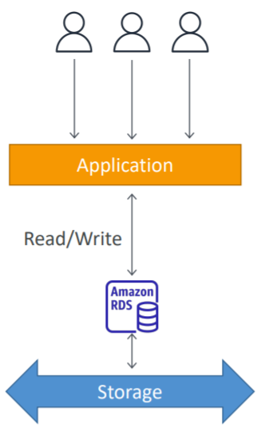
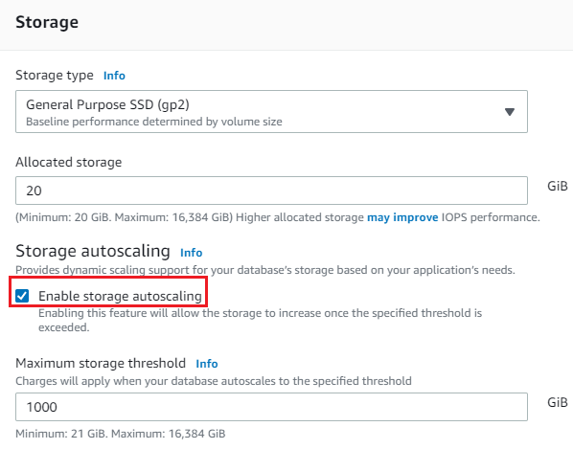
Relational Database Service
    Storage auto scaling
      Helps you increase storage on your RDS DB instance dynamically
      When RDS detects you are running out of free database storage, it scales automatically
      Automatically modify storage if:
        Free storage is less than 10% of allocated storage
        Low-storage lasts at least 5 minutes
      Usecases: applications with unpredictable workloads
Storage auto scaling
Setup

Slide 14
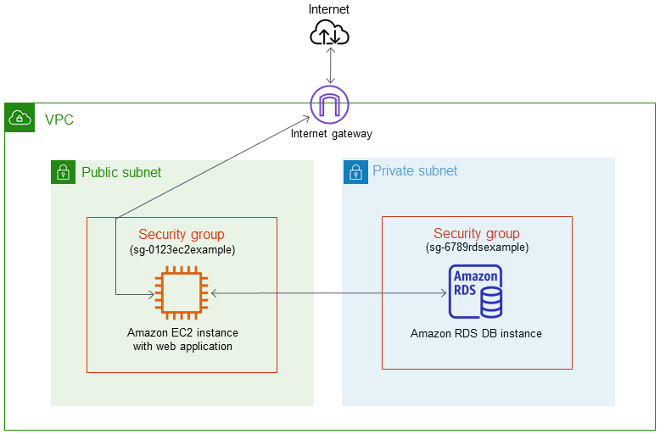
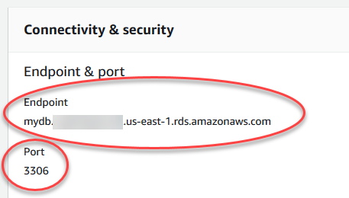
Relational Database Service
    Network
      Databases are usually placed in a private subnet
      Providing public IP for public access
    Endpoint
      To access database
      Including: endpoint & port, username & password
Database in Public subnet
Endpoint

Slide 15
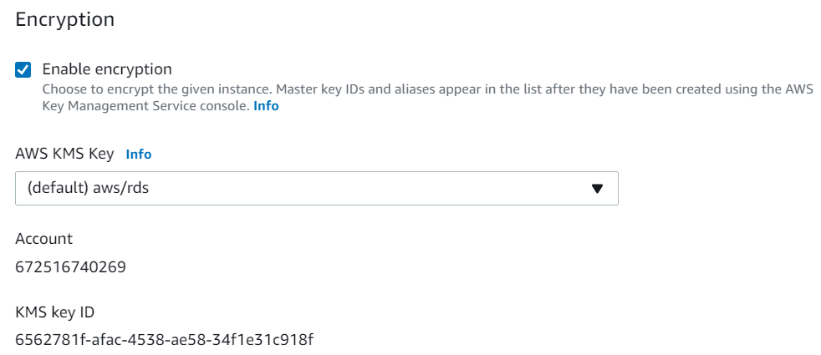
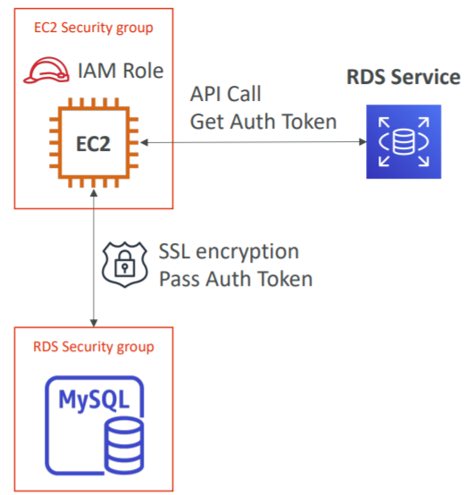
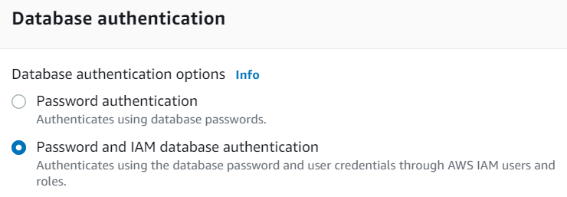
Relational Database Service
    Encryption
      At rest encryption with KMS
      In-flight encryption with SSL/TLS
    Database authentication
      Support both username & password and IAM Authentication
      IAM Authentication support MySQL and PostgreSQL
Encryption
IAM Authentication (Demo: Link )
Database authentication

Slide 16
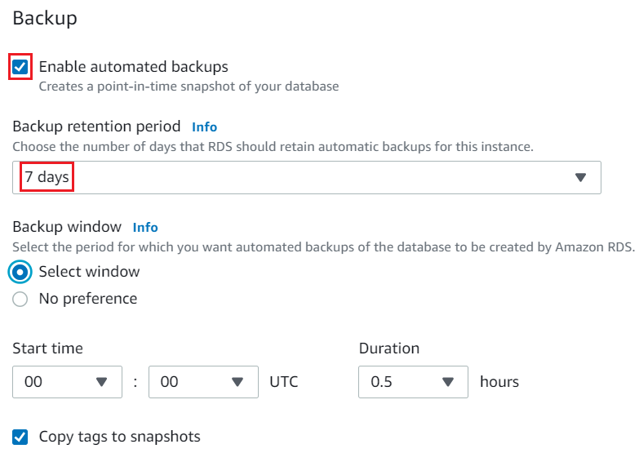
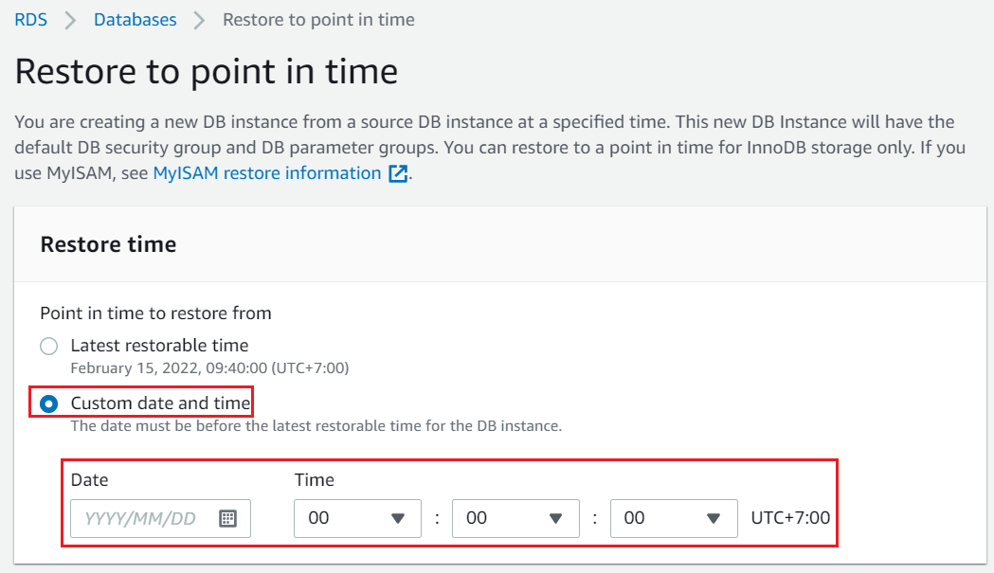
Relational Database Service
    Backup
      Including: snapshot, transaction logs
      2 types: manual backup, automated backup
      Default: Enable automated backup
      Automated backup
        Daily full backup of the database
        Transaction logs are backed-up by RDS every 5 minutes 🡺 ability to restore to any point in time (point-in-time restore)
        7 days retention (can be increased to 35 days)

Slide 17
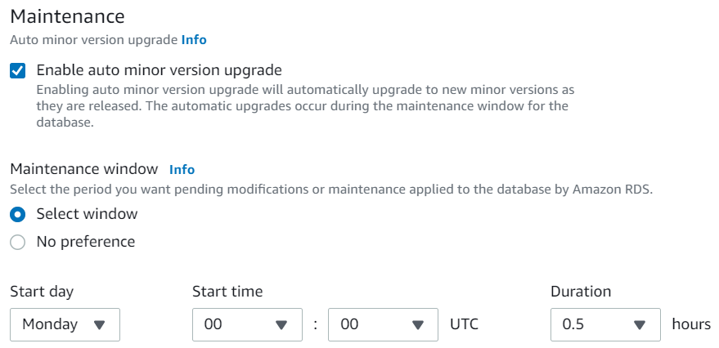
Relational Database Service
      Storing on S3, Incremental
      During the backup time, the performance will be reduced
      When restoring, a new database must be created 🡺 the endpoint changing 🡺 You will change code
        Restore manual snapshot: https://www.youtube.com/watch?v=vJQ5Q3LOQOw
        Restore manual automated backup: https://www.youtube.com/watch?v=JjdV4ErMXOo
    Maintenance
      AWS will perform updates under hardware, OS, database engine version
      During the update, performance is affected

Slide 18
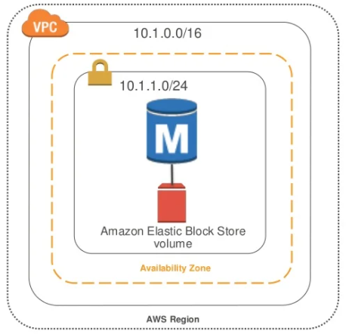
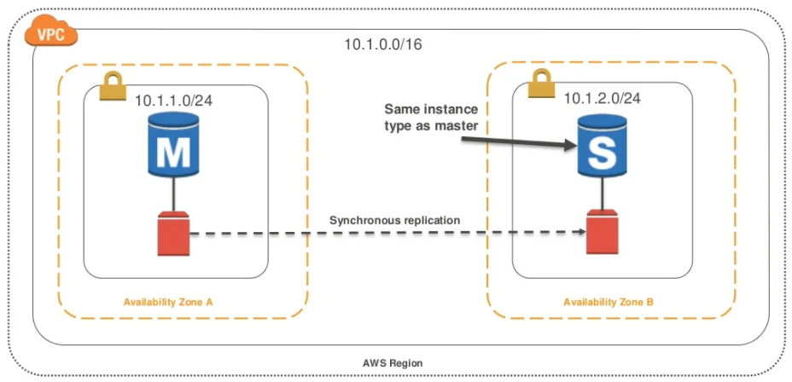
Relational Database Service
  Deployment
    2 types: Single-AZ Deployment, Multi-AZ deployment
Single-AZ Deployment
Multi-AZ Deployment

Slide 19
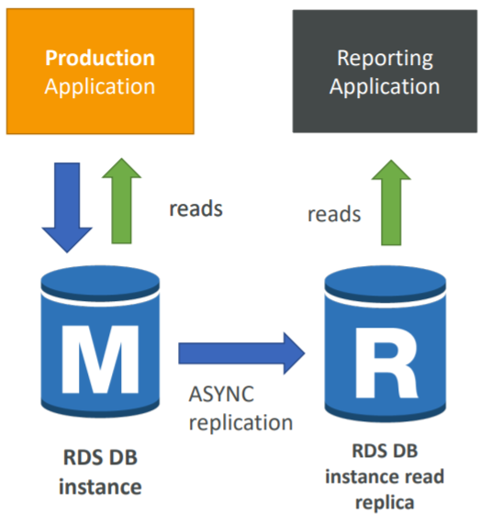
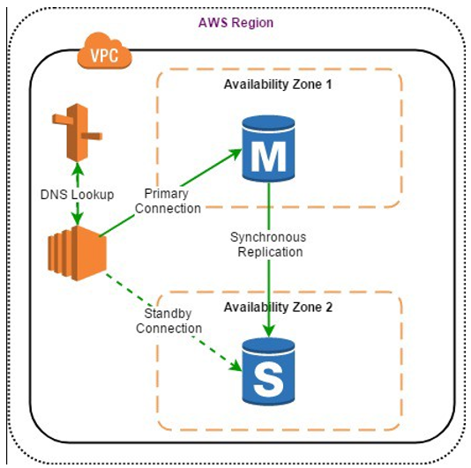
Relational Database Service
    Multi-AZ deployment
      Running DB instance on multiple zones to increase HA & failover
      Support EC2 instance and server on on-premises
      2 mode: Read Replicas, Standby replicas
      Usecases:
        Share workloads to other database instance
        Backup database

Slide 20
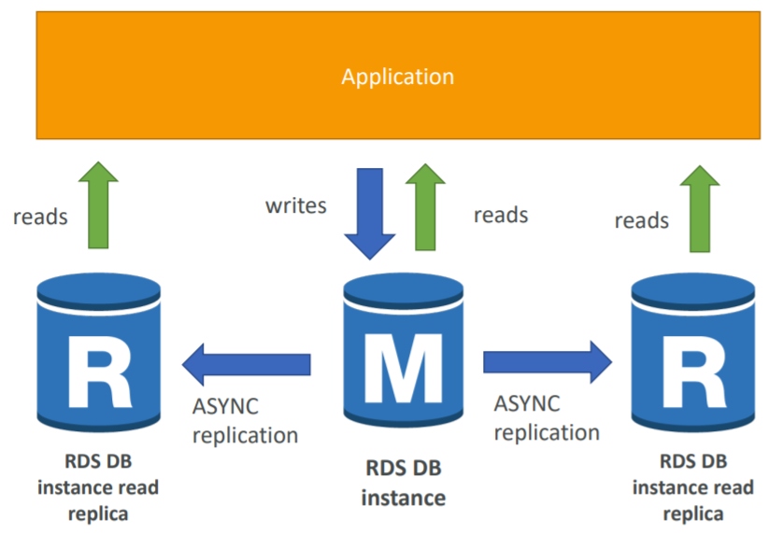
Relational Database Service
      Read Replicas
        Duplicate the Primary DB instance into many Secondary DB instances (Read Replicas DB) for reading request
        Primary DB using for writing/reading request, Read Replicas DB using for reading request
        Primary DB usually uses General SSD, and Read Replicas DB use Provision IOPS for storage
Read Replicas

Slide 21
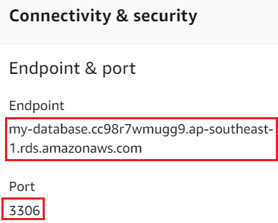
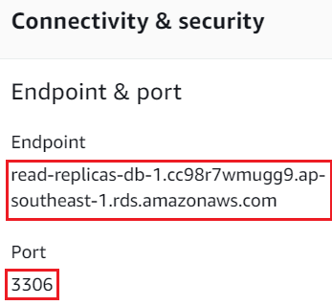
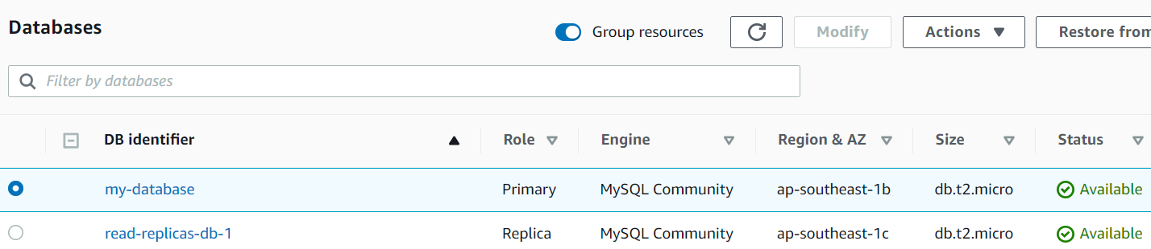
Relational Database Service
        AWS provides 2 independent endpoints for Primary DB instance & Read Replicas DB 🡺 Applications must update the connection string to leverage read replicas
        Replication is ASYNC (Near real-time synchronized)
        Up to 5 Read Replicas
        Usecases: share workloads with other database instance
Primary DB Instance Endpoint
Read Replicas

Slide 22
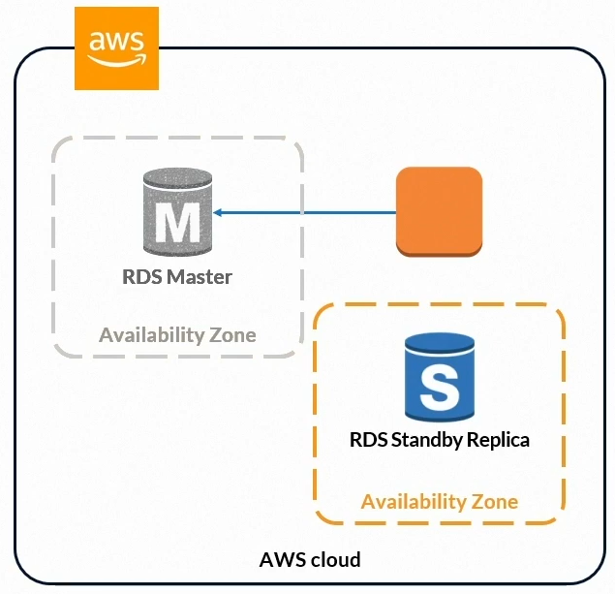
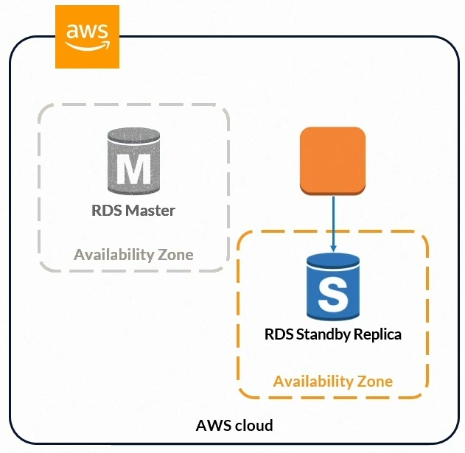
Relational Database Service
      Standby replicas
        Automatically backup primary DB instance and setup secondary DB instance on another zone (standby replicas)
        Usecase: backup Primary DB instance for Disaster Recovery, recommended use for production
        Only a endpoint for both Primary DB instance & Standby Replicas DB
        Automatic failover: When there is a problem with the Primary DB Instance, the Secondary DB Instance in another zone will be assigned as the primary key, without admin intervention (it takes about 60s 🡪 120s)

Slide 23
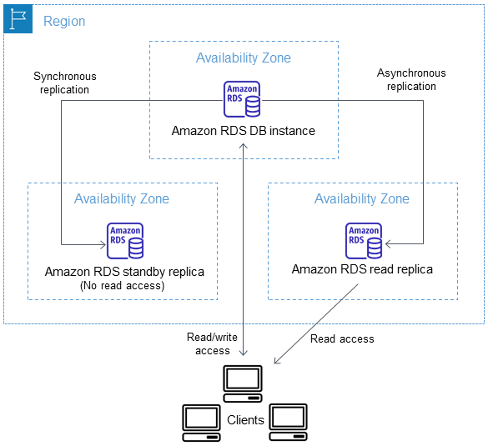
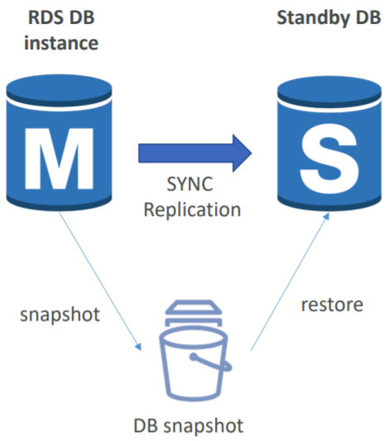
Relational Database Service
        Zero downtime operation (no need to stop the DB)
        Step
          A snapshot is taken
          A new DB is restored from the snapshot in a new AZ
          Synchronization is established between the two databases
      Read replicas & Standby replicas

Slide 24
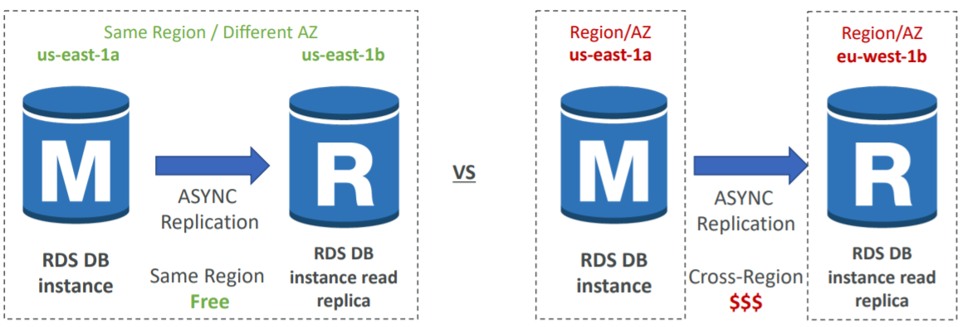
Relational Database Service
    Support Cross A-Z, Cross Region
      Same region: free
      Cross region: charged
    Demo
      Read replicas: https://www.youtube.com/watch?v=COsx7UrMGL4
      Make read replica writable: https://www.youtube.com/watch?v=j5da6d2TIPc

Slide 25
Assignment
  Self-practice

Slide 26
Relational Database Service
Advantage over using RDS versus deploying DB on EC2
  RDS is a managed service
  Automated provisioning
  Scaling capability
  Read replicas for improved read performance
  Multi AZ setup for Disaster Recovery, HA
BUT you can’t SSH into your database instances
  Storage backed by EBS
  Continuous backups and restore to specific timestamp (Point in Time Restore)!
  Maintenance windows for upgrades
  Monitoring dashboards

Slide 27
Summary
RDS is EC2 instance, support Relational Database (PostgresSQL, MySQL, Oracle, SQL Server, Aurora)
Components
  Hardware, Network, Security, Encryption, Lifecycle, ... similar to EC2 instance
  Engine information (MySQL, SQL Server, ...), Master account, Database, Connection information...
  Backup & Restore (S3), Retention period, Monitoring, Log, ...
Auto scaling storage
Encryption: At rest - KMS, In-flight - SSL/TLS
Authentication: Endpoint & port & username & password / IAM Authentication

Slide 28
Summary
Private/public access
Backup: including snapshot, transaction logs, manual backup/automated backup, 7 -> 35 days retention
Restore: point-in-time
Multi-AZ deployment
  Read Replicas: Share workloads to other database instance for minimize latency
  Standby replicas: for backup database
  Support multi A-Z: for high availability
  Support Cross Region

Slide 29
Q & A
Copyright © VTI Academy All Rights Reserved

